Slide 1

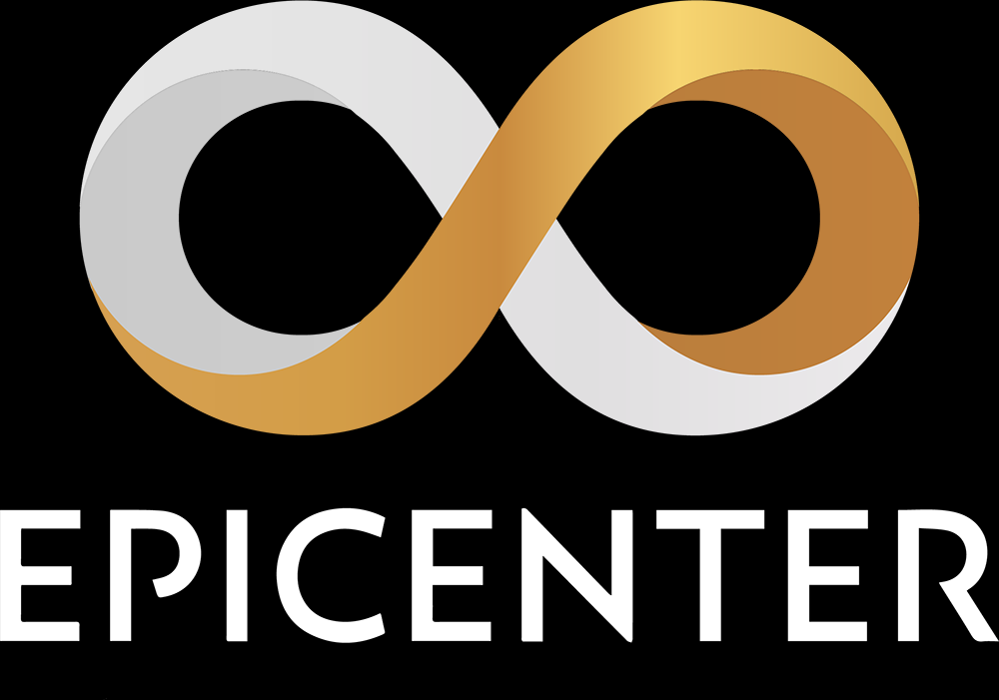


عملة مجانية
كل شهرين
لمدة 12 شهر
Air Grapفرصة العمر, توزيع مجاني
بمناسبة افتتاح ايبك سنتر بتاريخ 28/2/2021, سوف يقوم فريق ايبك سنتر بأخذ لقطة لكتلة سلسلة ايبك, مالكي ايبك كاش بتاريخ 28/2 سيكون لديهم الفرصة بالاشتراك في Air Grab والتي ستمنحهم عملة رمزية "توكن" ECR وبنفس قيمة ايبك كاش, EPIC 1000= ECR 1000
اذا قررت رهن ECR لدى ايبك سنتر سوف تتأهل بالمشاركة ب Air Grab كل شهرين ولمدة 10 اشهر قادمة للحصول على عناصر ايبك سنتر لنظامه البيئي, 1,000 ECR = 1,000 EMPL = 1,000 EON, حقيقة لهذه الدرجة من السهولة.
طريقة العمل
خلال العام القادم, ايبك سنتر سوف يقوم باطلاق ستة عملات رمزية على الأقل وذلك لكي ينمي نظامه البيئي, لمشاهدة القائمة الكاملة
وتواريخ الاطلاق أدناه
Epic Cash holders must have their EPIC in one of 3 places on Feb 28TH to participate in the Air Grab.
EPIC held anywhere else, such as in these places on Feb 28TH cannot participate in the Air Grab:
CLI wallet
GUI wallet
Vitex (in either the exchange or their own wallet)
Official Epic ERC20 token
Citex
Fast Epic (FEPIC)
Any other unofficial wrapped EPIC on other chains
On February 28th, the team will take a snapshot of the blockchain that will be used as the oracle of holdings.
We will then set up an Air Grab Portal where you will need to add your telegram handle, the number of EPIC you are holding and your ERC20 wallet address for the ECR tokens to be sent to (more details on this to come).
For those concerned about privacy, we don’t want your name or your email address, but we might need to contact you on Telegram in case we can’t match up your claim to the snapshot. We won’t be using your details for anything other than this one-off process.
On March 28th 2021, ECR tokens will distributed to those who have made their claim.
To participate in further token rounds, you will need to stake your ECR tokens with Epicenter (more on how to do this nearer the date).
WHAT IF I DON’T HAVE ANY EPIC CASH?
It’s not too late to buy some. We’re currently listed on a decentralised exchange called Vitex (vitex.net) where you can buy as much as you like.
WHAT TOKENS ARE BEING LAUNCHED AND WHAT DO THEY DO?
ECR
March 28th 2021
Utility and governance token of Epicenter ecosystem that gives you rights to participate in future token offerings and governance of the decentralized organization.
EMPL
May 2021
Soft-pegged algorithmic stablecoin that rebases to $1 value periodically, adjusting the in-wallet balances of users up or down as necessary – great for smart contracts where the value needs to be fixed.
EON
July 2021
A smart contact platform that handles administrative duties within the ecosystem, tying the chains together.
EDX
September 2021
Epicenter Dex utility token for fees, trade and get fee rebates.
ECHO
November 2021
A token that stores the seeds of the content you create and share online. It allows you to own your own data and transact with others without big tech centralized systems and all the benefits that brings.
EFX
January 2022
Epicenter Forex enables you to send any fiat to any fiat, through the blockchain, cheaply and instantly. No more $45 wire transfer fees!
WHAT IS EPIC CASH?
If you’re not familiar with Epic Cash, head to https://epic.tech to find out more.
THE SMALL PRINT: You recognize and agree that we have made no implications, warranties, promises, suggestions, projections, representations or guarantees whatsoever to you about future prospects or earnings, or that you will earn any money or tokens, with respect to the ECR and subsequent air grabs, and that we have not authorized any such projection, promise, or representation by others. You recognize and agree that we have made no guarantees as to the timing of said air grabs.
Epicenter is a no ICO, no pre-mine, no VC community project represented by the ECR DAO, currently led by pseudonymous individual volunteer contributors known as the Freeman Family. Anyone can become a Freeman simply by creating a free profile on EpicFundMe.com so that others know how to pay you, since Epic Cash has no publicly visible wallet addresses, for improved privacy. Epicenter creates regulatory compatible digital assets that are designed to not be securities, under the guidelines established by the Crypto Rating Council. This is not an offer to sell securities, and ECR tokens require active contribution to participate. Token-holders play an active role in shaping the ongoing evolution of the ecosystem through their presence and engagement.
No admin will ever ask for your keys or your KYC information. No marketing will ever pollute your feeds. Epicenter respects privacy and the valuable limited time and attention of its users.
The best way to get Epic is not to buy it, it is to earn it, through mining or asking to be paid in it for the goods and services you provide to others. Epic Cash is a true P2P unstoppable electronic cash system according to the original Satoshi design, updated to the latest tech standards using Mimblewimble and Multi-Algo.
Epicenter Labs is hiring! If you have experience in Rust, React, Dfinity, Loopring, Hermez, Zksync, Solidity, BSC, HECO, Solana, Vite, gossip protocols, high assurance DevOps, secure multi party computation, or the aptitude to learn, say hi at labs.epic.tech - bounties available daily, which can lead to more permanent engagements. Epicenter is committed to high assurance free open-source software that adds immediate value to people's lives by adding value today, not years down the line.
ECR Air Grab One Pager v0.5

